Slide 1
The six steps to hand washing

Slide 2
Step one
Step one is to get a paper towel and set it by the sink

Slide 3
Step two
For step two you need to turn on the water as hot as you can stand it the reason for turning on water before you get soap is so you don’t have to touch the handle after getting the soap. When you get the water as hot as you can stand it you move to step three.

Slide 4
Step three
Get soap and rub your hands together for 30 seconds that way the soap can get all the germs off.

Slide 5
Step four
The four step is to rinse your hands always wash your hands down ward so the germs will rinse off.

Slide 6
Step five
Step five is to get the paper towel and dry your hands off.

Slide 7
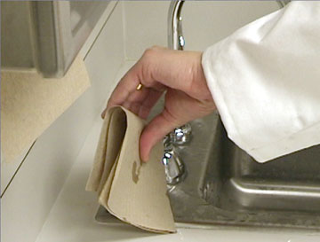
Step six
Shut the water of with the paper towel so you don’t get any germs after just washing your hands.

